Slide 1


From the Brick to the click

Slide 2

innovation
Key challenges
Internet is an important channel for new segments, especially younger players . 57% are in age group 18-45.
Internet gaming has not cannibalized retail lottery sales. Retail sales grew more for lotteries with internet than for lotteries without.

Slide 3

evolution

Slide 4

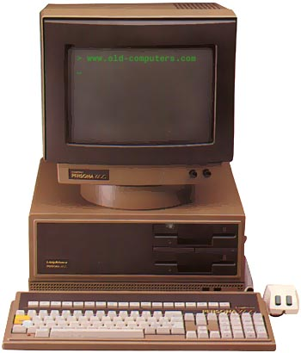
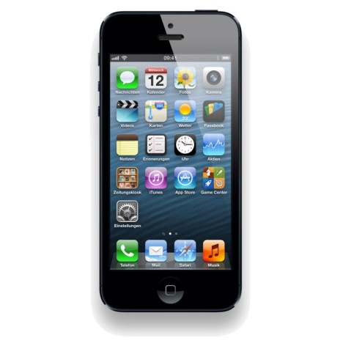
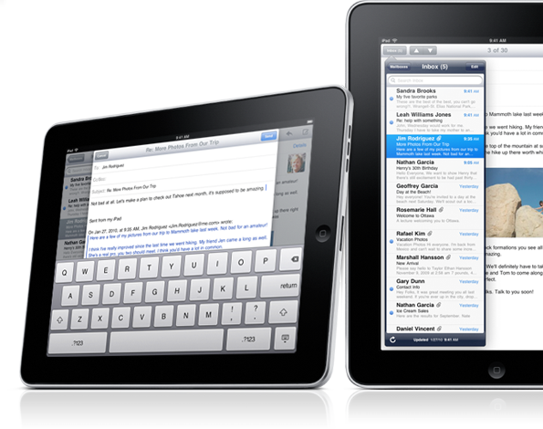
EVOLUTION IN COMPUTING
Then
Now

Slide 5

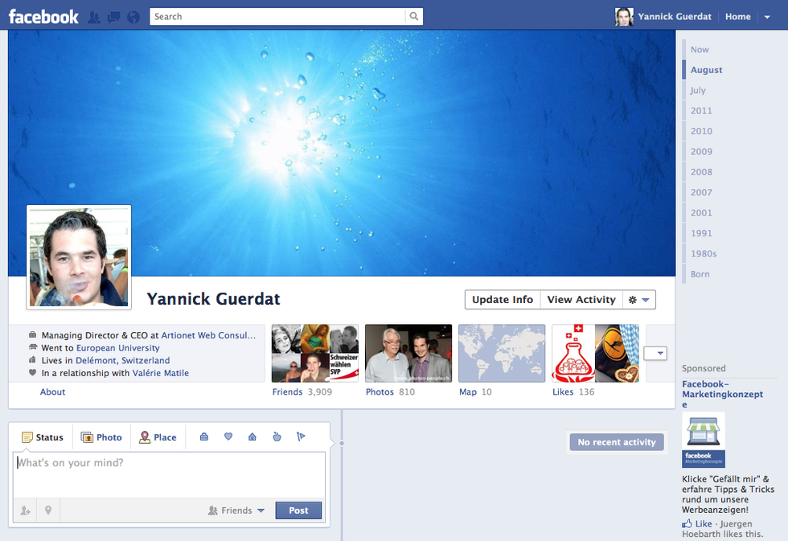
EVOLUTION IN LIFE STORY-TELLING
Then
Now

Slide 6

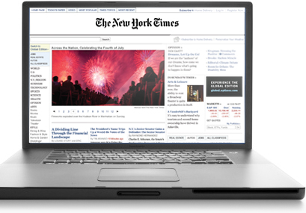
EVOLUTION IN NEWS
Then
Now

Slide 7
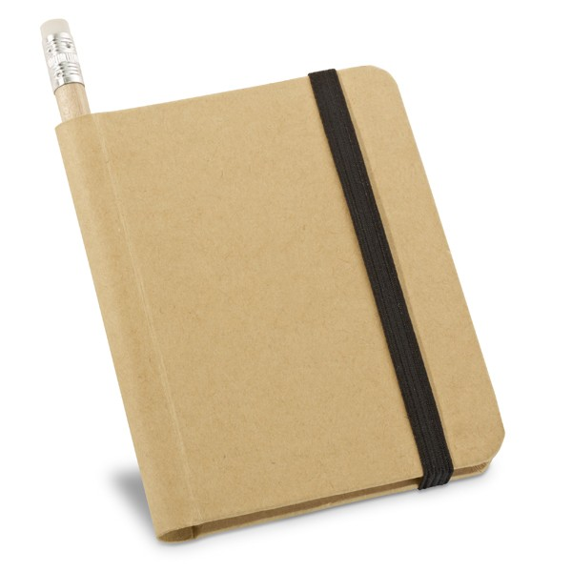

EVOLUTION IN NOTE TAKING
Then
Now

Slide 8

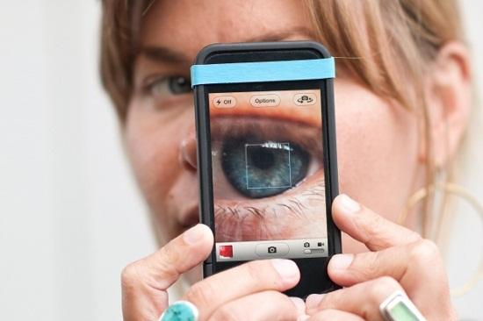
EVOLUTION IN PHOTOGRAPHY
Then
Now

Slide 9
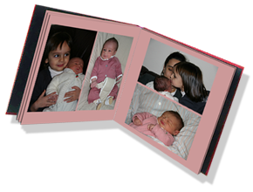
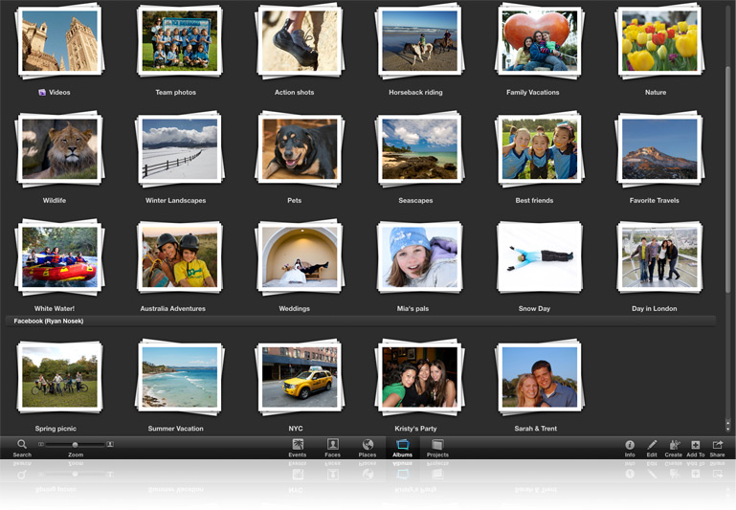
EVOLUTION IN SCRAPBOOKING
Then
Now

Slide 10


EVOLUTION IN MAGAZINES
Then
Now

Slide 11

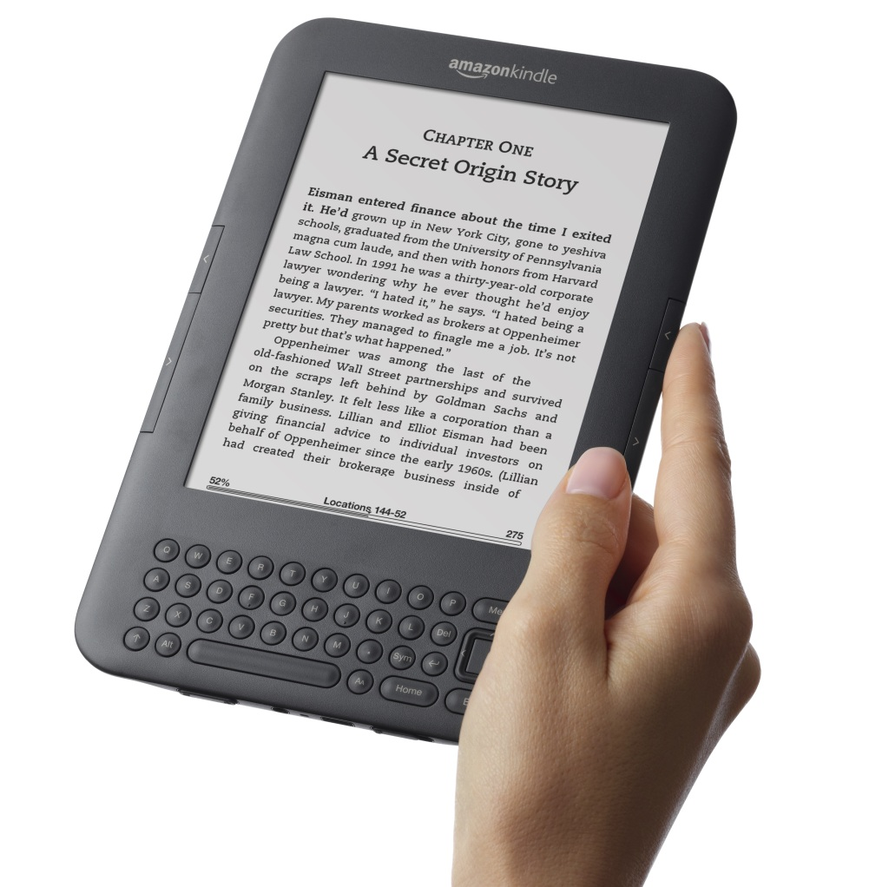
EVOLUTION IN BOOKS
Then
Now

Slide 12
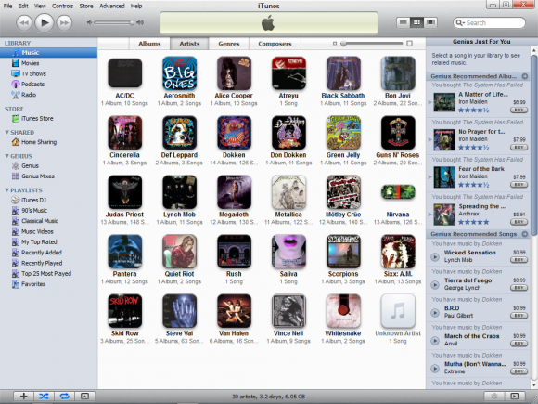

EVOLUTION IN MUSIC DISTRIBUTION
Then
Now

Slide 13

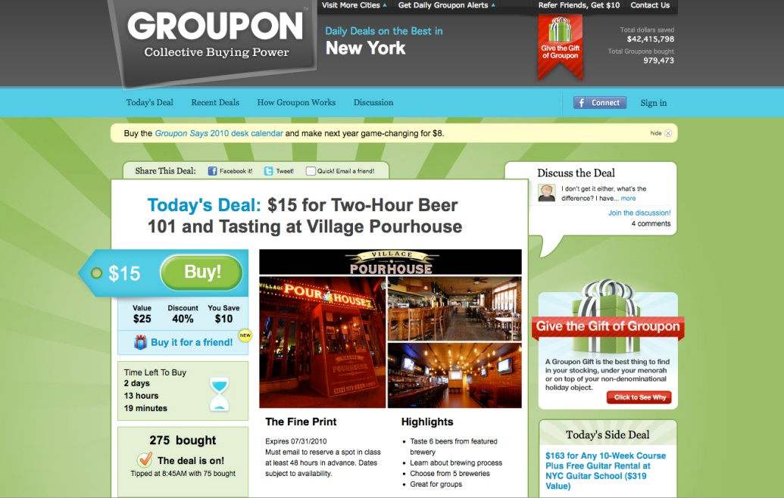
EVOLUTION IN COUPONS
Then
Now

Slide 14
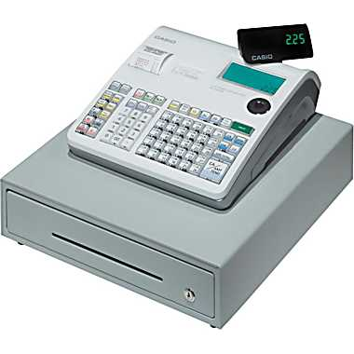
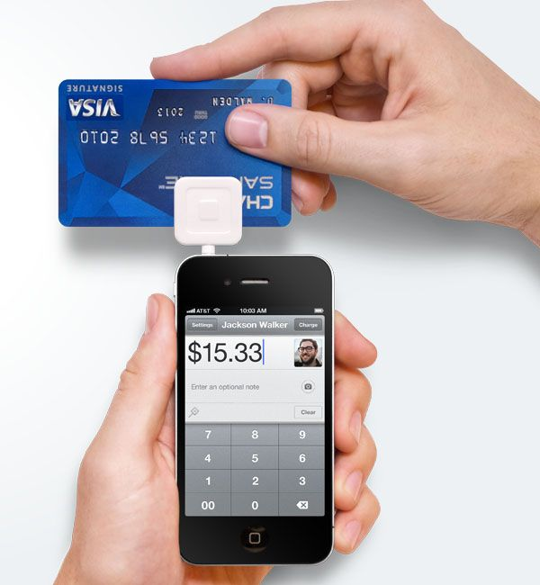

EVOLUTION IN RETAIL
Then
Now

Slide 15
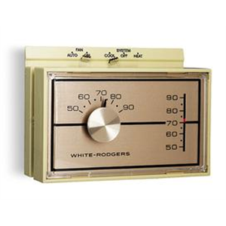
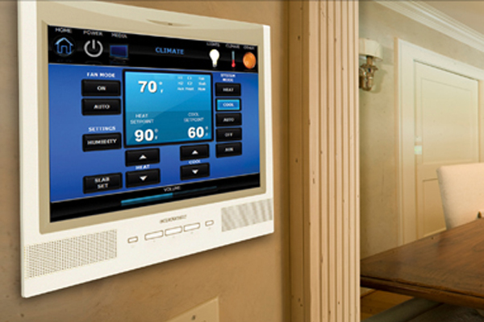
EVOLUTION IN CLIMATE CONTROL
Then
Now

Slide 16
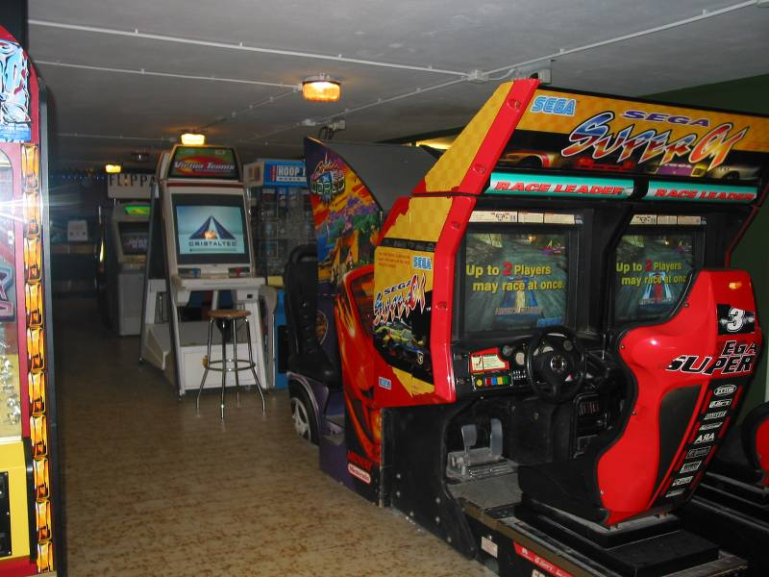
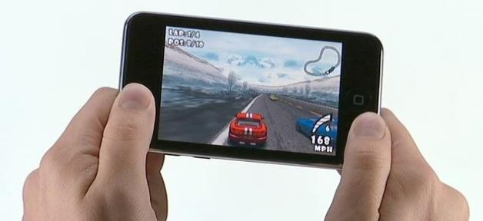
EVOLUTION IN GAMING
Then
Now

Slide 17
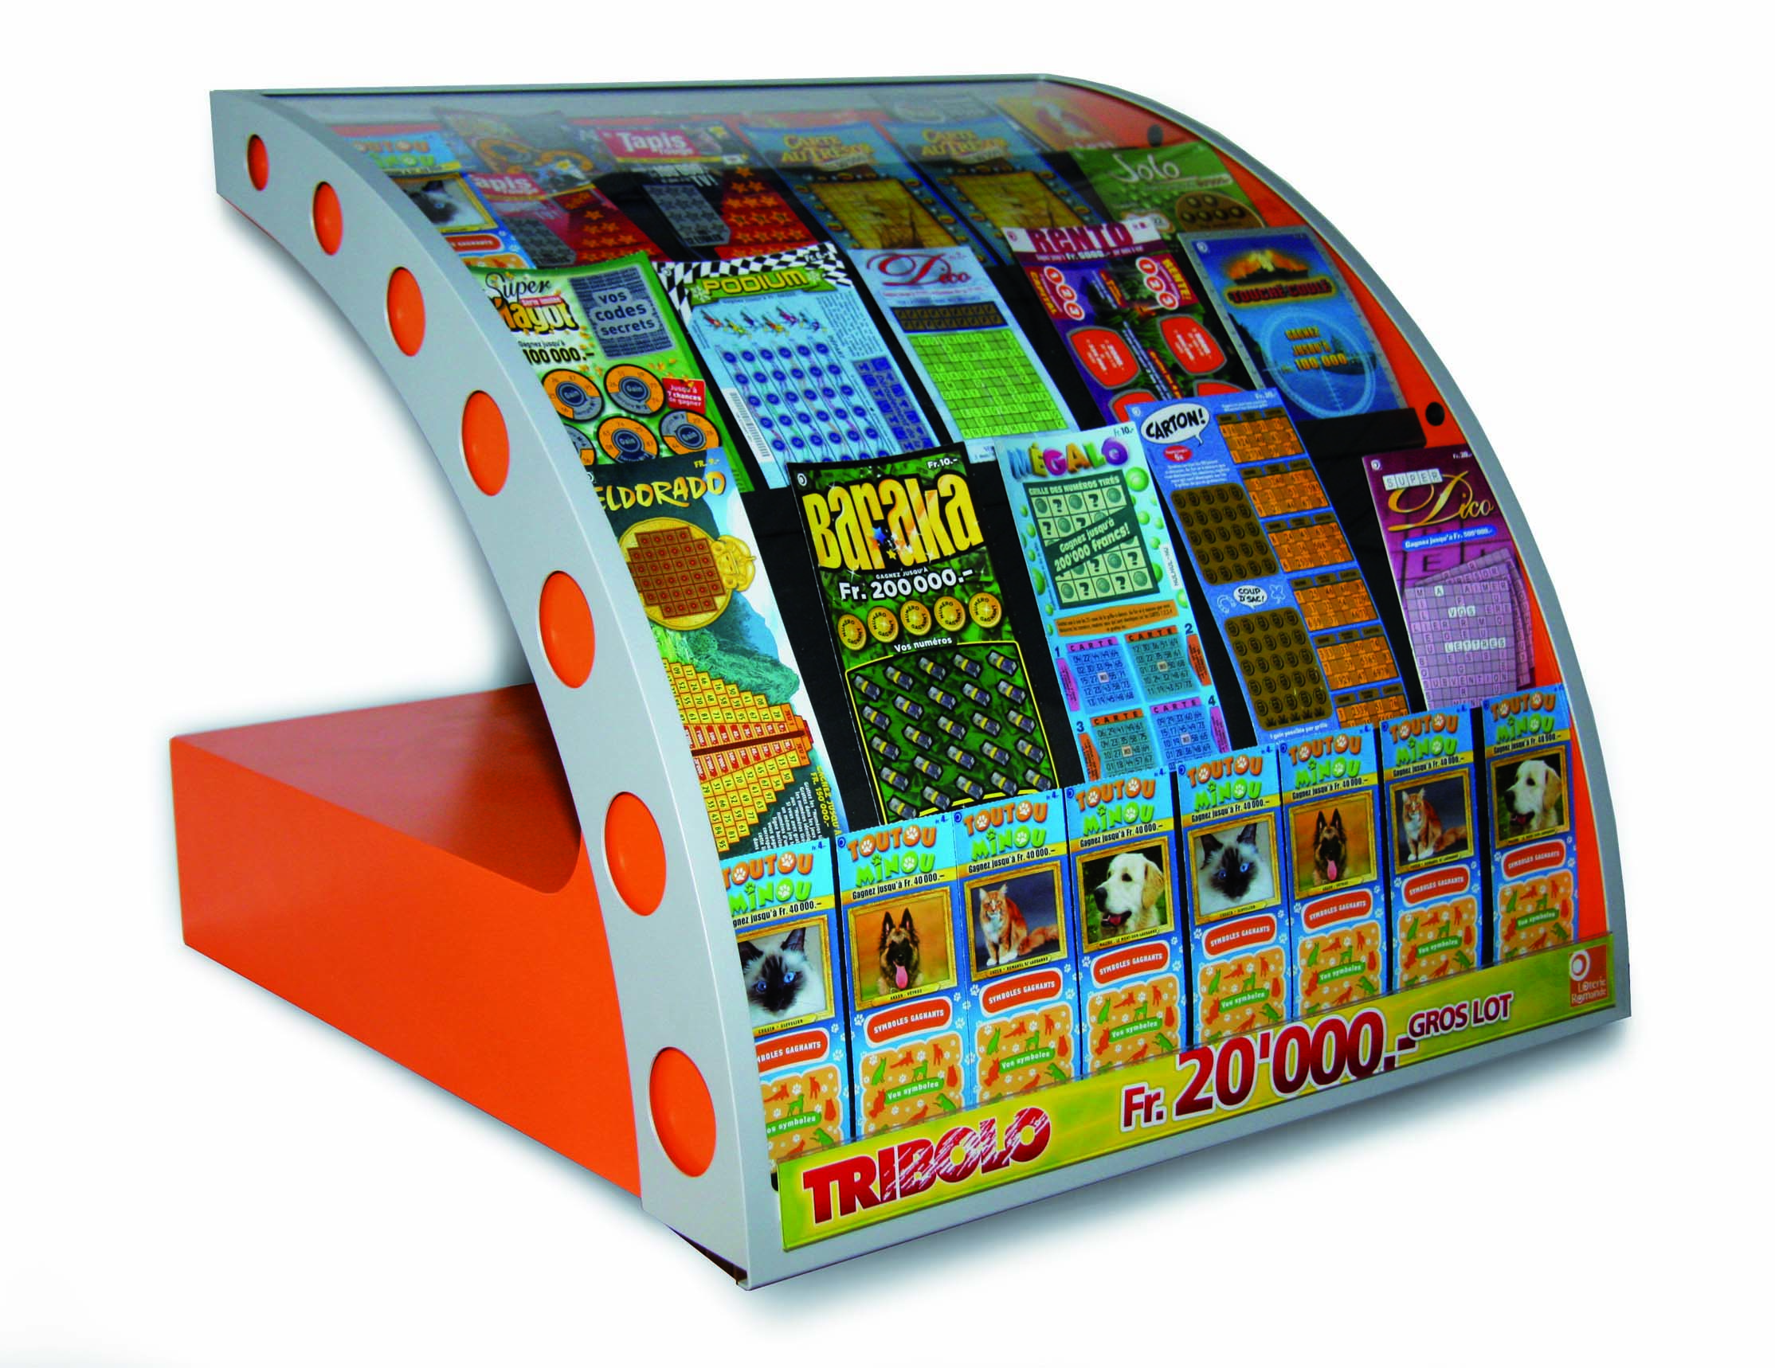
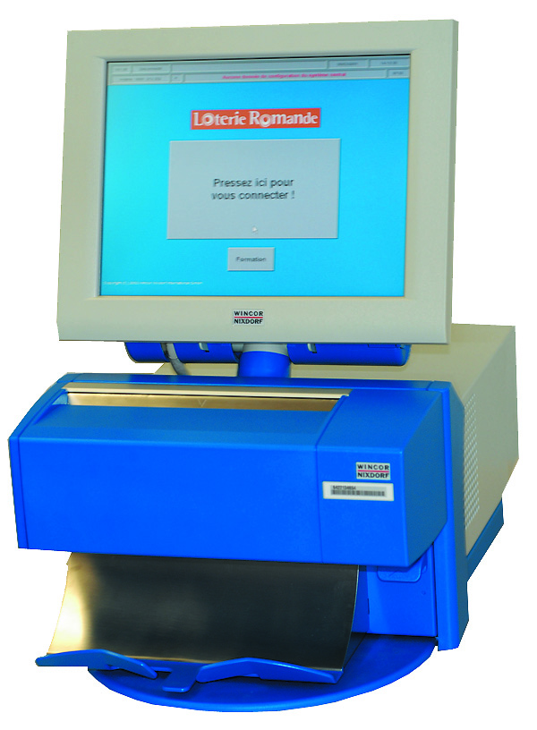
EVOLUTION IN LOTTERY
Then
Now

Slide 18

generation

Slide 19
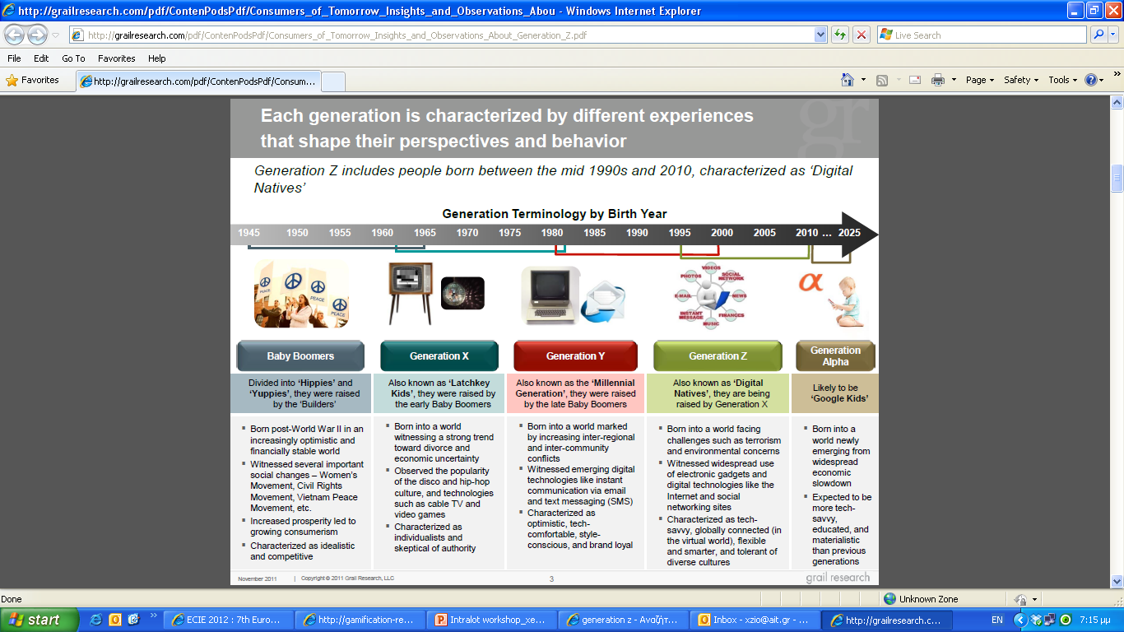
innovation

Slide 20


Slide 21
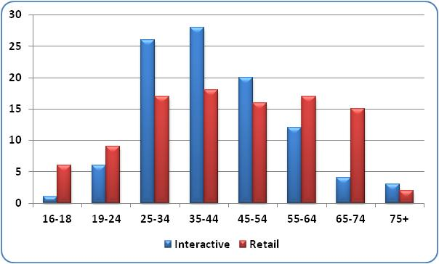
innovation
Lottery player profile
UK Lottery Player Profile By Age and Channel
Source: Camelot

Slide 22
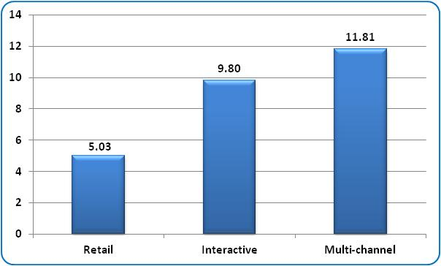
innovation
Lottery spending
UK Lottery Player Spend By Channel (US$)
Source: Camelot

Slide 23

internet

Slide 24

innovation
why internet playing?
Offering lottery games via the Internet means you can:
Reach more customers
Reach new categories of customers
Learn more about your customers, their behaviour & preferences
That means you can:
Undertake more efficient marketing and promotion
Attract and retain customers more effectively
Increase sales

Slide 25

why eCommerce ?
not only about sales
But….
building Relationships (eCRM)
2) bringing the new consumer in
3) creating a new type of game

Slide 26

1. building Relationships (eCRM)

Slide 27

what is eCRM?
eCRM: all forms of managing relationships with consumers making use of information technology

Slide 28

the benefits of eCRM in gaming
better knowledge of consumer insights
improve marketing decision making
increase efficiency
enables measurement, leading improvements
Responsible Gaming functionalities

Slide 29

2. bring The new consumer in

Slide 30




the new Consumer
rarely visits the Point of Sale
is always connected
is used to buying and playing online
wants everything accessible 24h/7

Slide 31

3. create a New type of Games

Slide 32


better interactivity
Geo Sweep
Treasure Hunt

Slide 33
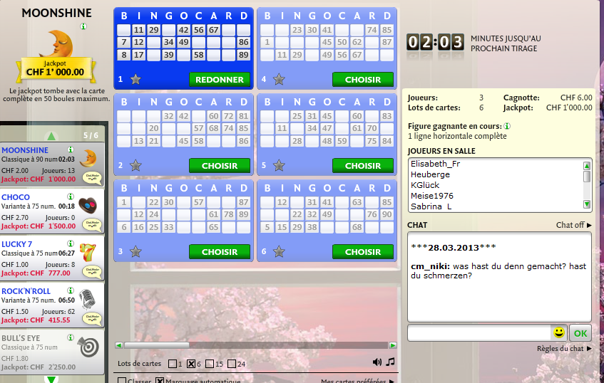
create a community
bingo with Chat

Slide 34

retail

Slide 35
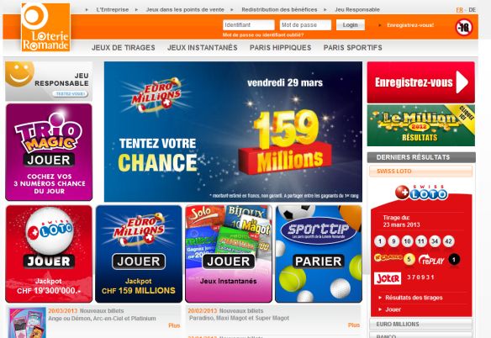
innovation
Impact on lottery retailers
loro online market share reaches 8,5 %
lottery retail sales growing at 4,9 % annually
loro.ch growing at 16,4% annually
Source: Loro sales 2010/2012

Slide 36
innovation
Impact on lottery retailers
Sales in retail (CHF)
Sales on internet(CHF)
Source: Draw Games / Loro sales / 2007/2012

Slide 37

opportunities

Slide 38
multi-channel opportunities
Pre-paid voucher commission for POS
Cross-promotion campaigns
Marketing affiliates (1 fee with online activation)

Slide 39
Offering lottery sales via Internet
Increases sales
Fits in with changing consumer behaviour
Opens up a new source of players
Gives greater customer insight
Allows more tailored promotional activity
Stimulates greater spending
Develops Responsible Gaming approach

Slide 40
Thank you

