Slide 1
Consumers Across Lottery & Gaming
Jim Kennedy
CEO Lottery Group
Scientific Games

Slide 2
“2015…The Main Challenge”
“The main challenge facing the industry during the next five years is knowing who its consumers are, understanding their changing needs and behaviors, and staying close to them, thereby ensuring the experience they provide is sufficiently compelling to override other potential choices. This need applies in all segments and countries, and at all levels of spending, from occasional online gamblers to avid social networkers to casino-loving high rollers.“
Global Gaming Outlook PWC - 2015

Slide 3
“THE great obstacle to discovering the shape of the earth, the continents, and the ocean was not ignorance but the illusion of knowledge”
Boorstin, Daniel J. The Discovers

Slide 4
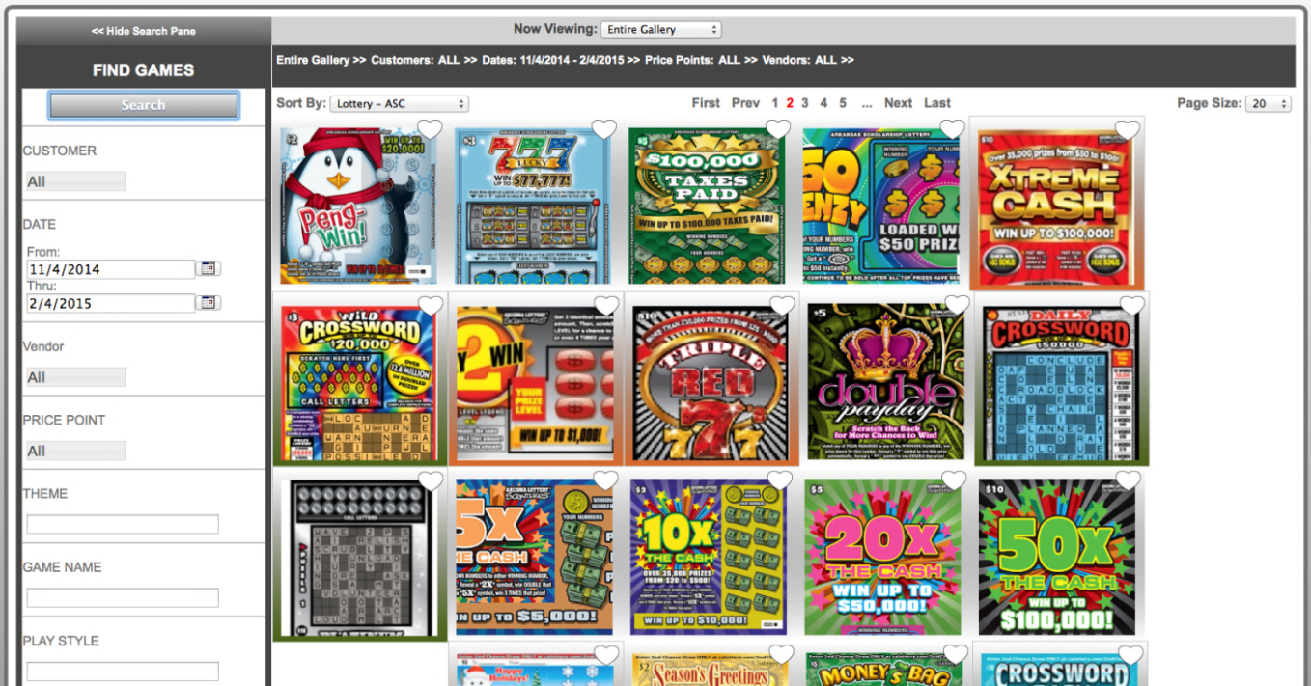
2001: The Instant Game Index: the Science of the Games
40,000
2 Million
Instant Games
Weeks of Sales

Slide 5
The Consumer Focus
Scientific Games takes a unique Initiative
+

Slide 6
Deep Segmentation on Consumer Motivations Across Lottery AND Gaming

Slide 7
5 Questions Answered
Implications for measureable product development

Slide 8
Motivations for general gaming are different across the U.S. and Europe?
1
The same motivational segmentation model applied for gaming in the U.S. and Europe.
While each segment varies in penetration and spend, core motivations are the same.
ULTIMATE
DEDICATED
OUTGOING
PRE-ULTIMATE
RESERVED
DABBLING
ULTIMATE
DEDICATED
OUTGOING
PRE-ULTIMATE
RESERVED
DABBLING

Slide 9
There is little cross-over in gaming behavior?
2
There is a high degree of cross-over in gaming behavior
50% of instant game players play slots
75% of slot players play draw games
74% of slot players play instant games
32% of instant game players play social games

Slide 10
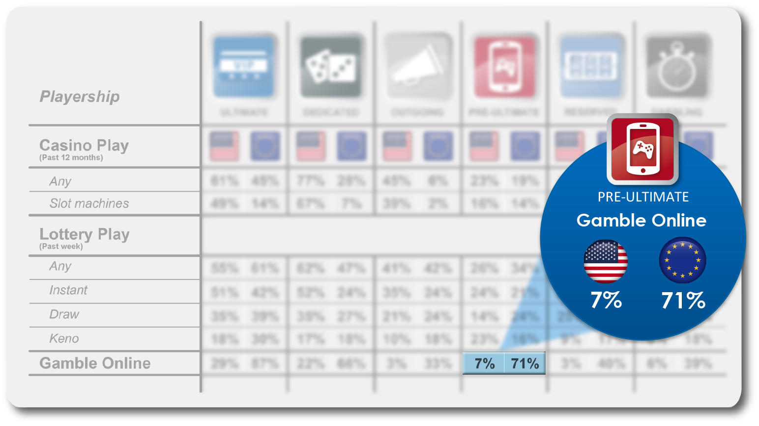
Segmenting by market shows more distinction across play.
PRE-ULTIMATE
Gamble Online
7%
71%

Slide 11
Young people are not interested in lottery?
3
Young people ARE interested in lottery
Pre-Ultimate’s Under 30: 39%
Motivations: Similar to Ultimate Entertainment, Thrill, Immersion
Spend: Low due to low discretionary income likely to have moved or started a new job in last 12 months
Behavior: High in online social games, fantasy sports and home games

Slide 12
4
ROI can be Estimated in Product Design?

Slide 13
4
…by Alignment of Motivations to Design.

Slide 14
5
The Instant Game is a Category Versus a Single Product?
The relationship consumers have with instant games is more complex than other categories and respond to segmentation for actionable product development.

Slide 15
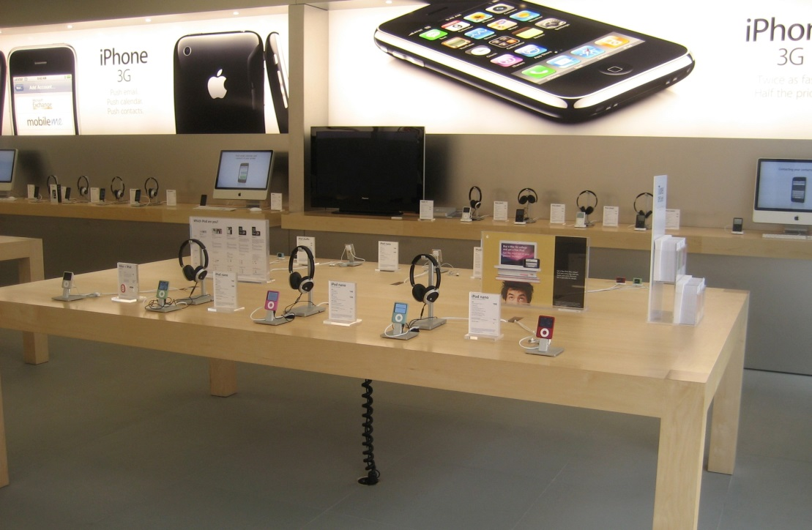
Two Profit Models
Publix Net Profits = ~ 6%
Focus on Cost
Apple Net Profits = ~22%
Focus on Sales

Slide 16
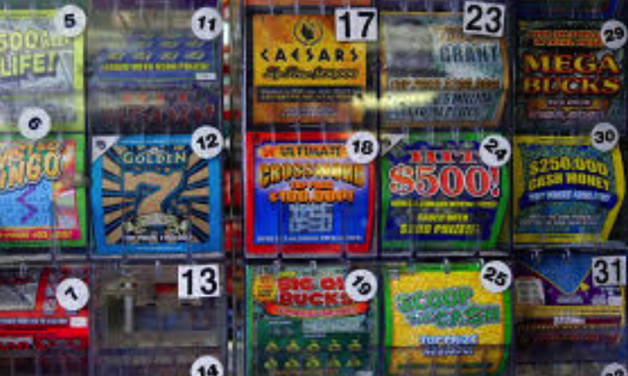
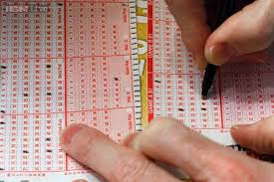
Consumer Interface
$284.3 Billion Global Industry
Lottery net profits = ~25%
Focus on…

Slide 17
The Consumer IN the Game

Slide 18
The Consumer
the integrating factor
+
Thank You

